Slide 1
Agent Based Modeling - Mesa

Slide 2
Overview of Agent Based Modeling
Computer based model to simulate the behavior of individual agents
An agent is any entity which can be considered to behave autonomously, assessing its own individual situation and making decisions based on this situation according to a set of rules.
ABMs are widely used in a variety of disciplines to simulate dynamical behaviors of systems made of a large number of entities

Slide 3
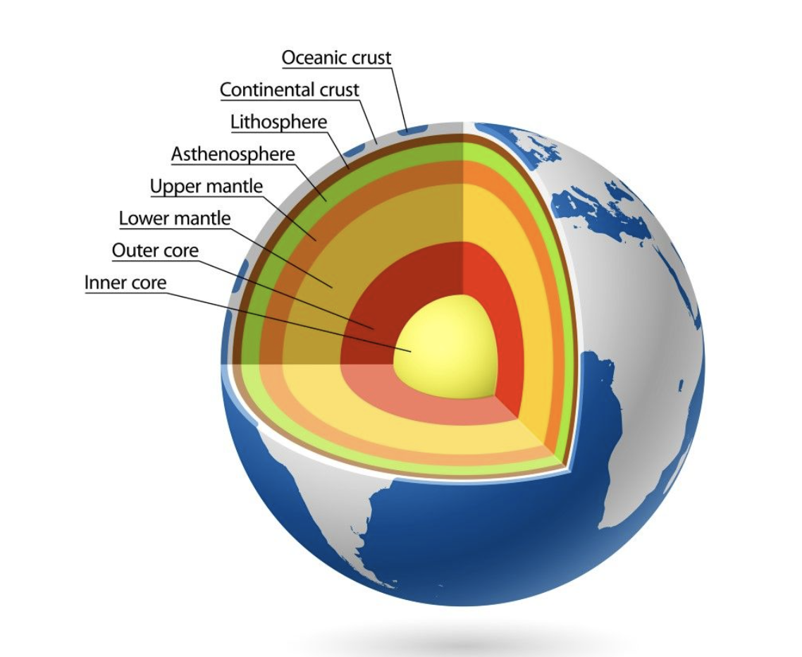
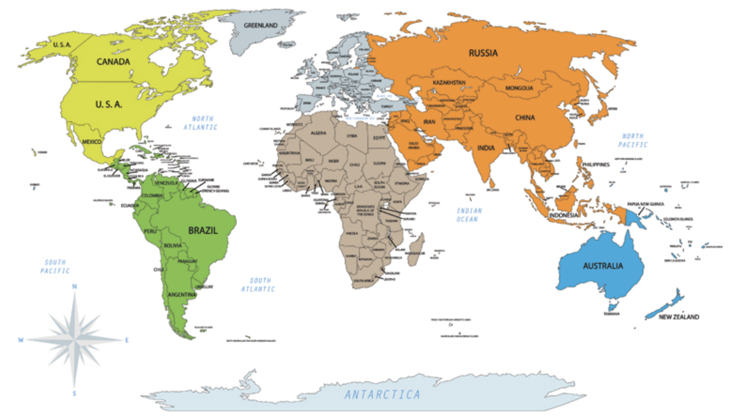
Overview of Agent Based Modeling
Modeling includes the process of mapping the problem from the real world to its model in the world of models, – the process of abstraction, – model analysis and optimization, and mapping the solution back to the real system. Earth Model

Slide 4
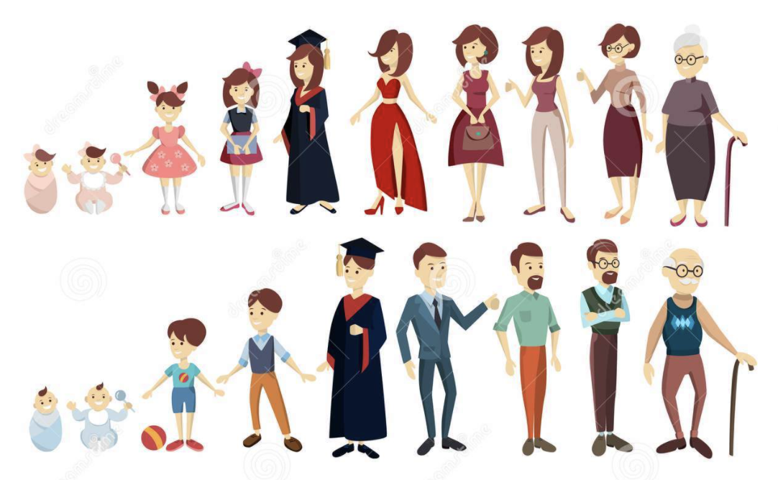
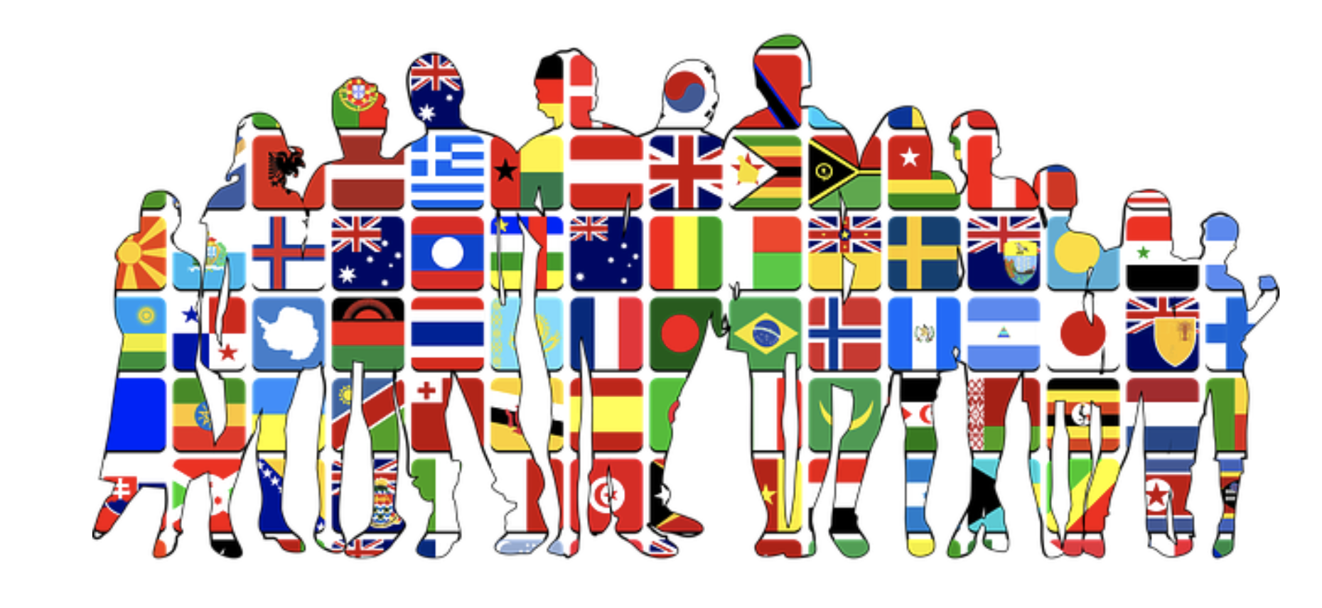
Overview of Agent Based Modeling

Slide 5
Overview of Agent Based Modeling
The defining feature of the agent-based modeling approach is that it establishes a direct and explicit correspondence:
- between the individual units in the target system to be modeled and the parts of the model that represent these units (i.e. the agents), and also
- between the interactions of the individual units in the target system and the interactions of the corresponding agents in the model

Slide 6
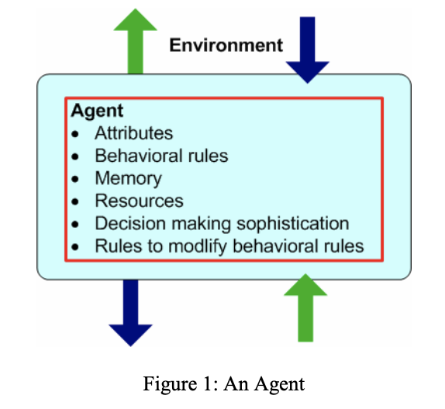
Overview of Agent Based Modeling

Slide 7
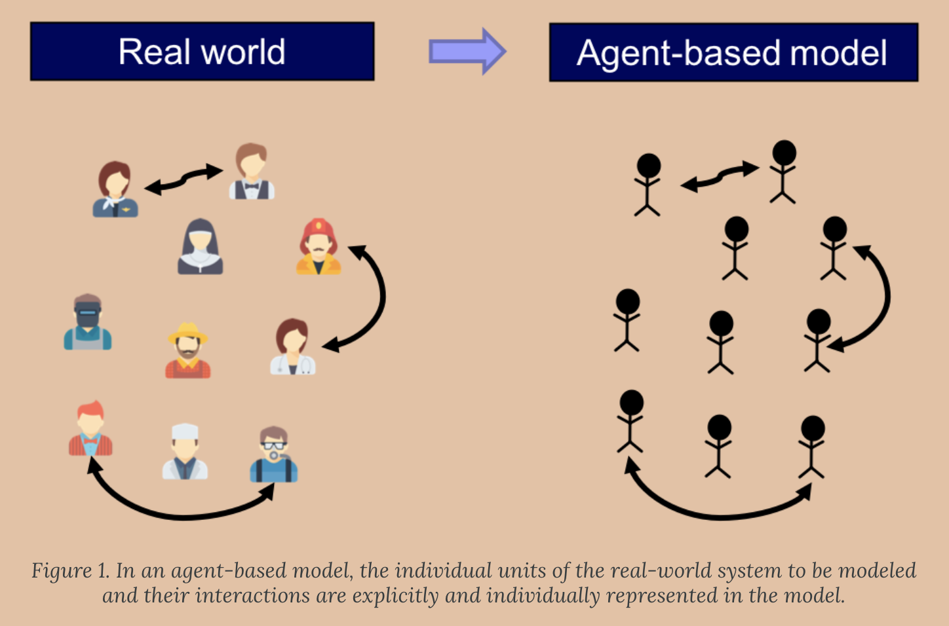
Overview of Agent Based Modeling

Slide 8
Overview of Agent Based Modeling
Agents are discrete entities.
Agents may have internal states.
Agents may be spatially localized.
Agents may perceive and interact with the environment.
Agents may behave based on predeﬁned rules.
Agents may be able to learn and adapt.
Agents may interact with other agents.
ABMs often lack central supervisors/controllers.
ABMs may produce nontrivial “collective behavior” as a whole.

Slide 9
Overview of Agent Based Modeling
Speciﬁc problem to be solved by the ABM
Design of agents and their static/dynamic attributes
Design of an environment and the way agents interact with it
Design of agents’ behaviors
Design of agents’ mutual interactions
Availability of data
Method of model validation

Slide 10
Overview of Agent Based Modeling
In order for an ABM to be scientiﬁcally meaningful, it has to be built and used in either of the following two complementary approaches:
Build an ABM using model assumptions that are derived from empirically observed phenomena, and then produce previously unknown collective behaviors by simulation.
Build an ABM using hypothetical model assumptions, and then reproduce empirically observed collective phenomena by simulation.

Slide 11
Agent Based Model
Important component of ABM -> Interaction between agents and their environment.
The environmental state is still part of the system’s overall state
Environmental state is deﬁned over space, and not associated with speciﬁc agents.
The environmental state dynamically changes either spontaneously or by agents’ actions (or both).
The importance of agent-environment interaction is well illustrated by the fact that NetLogo [13], a popular ABM platform, uses “turtles” and “patches” by default, to represent agents and the environment, respectively.

Slide 12
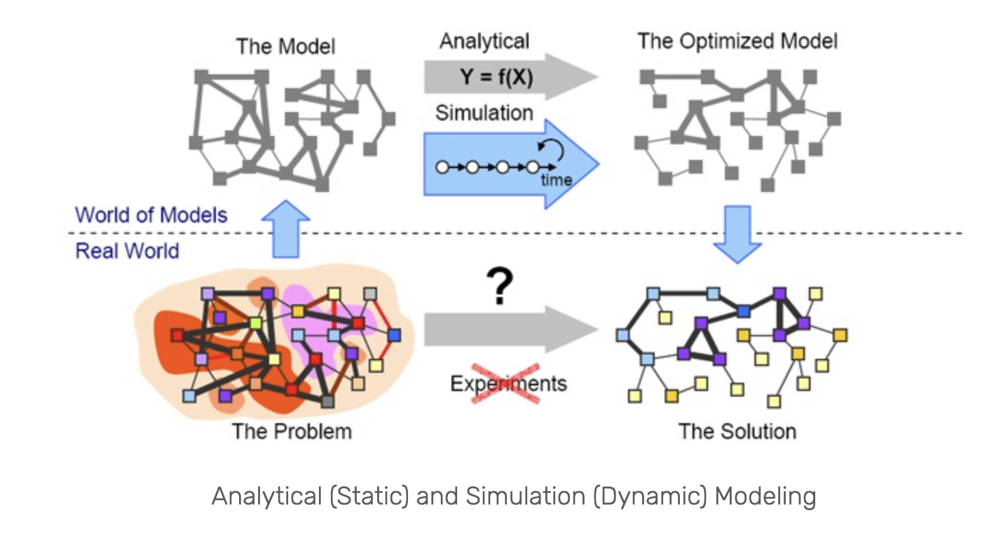
Overview of Agent Based Modeling
Event to Practical Agent Based Modeling: Reasons, Techniques, Tools
Andrei Borshchev and Alexei Filippov. The 22nd International Conference of the System Dynamics Society, July 25 - 29, 2004, Oxford, England

Slide 13
Case Study 1: Using Agents to Simulate Financial Transactions
PayMoney app is a service for performing financial transaction using a mobile phone
The app needs to have protection against financial fraud like money laundering.
Since the app is newly launched, it does not have enough data to use advanced machine learning techniques to detect money laundering or any other kind of anomalies like fraud detection.
An agent based model can be trained to generate synthetic data and study the financial transactions to detect anomalies in transaction behavior.

Slide 14
Overview of Agent Based Modeling Frameworks
Amp.The AMP project provides extensible frameworks and exemplary tools for representing, editing, generating, executing and visualizing agent-based models (ABMs) and any other domain requiring spatial, behavioral and functional features.
Entorama – Entorama is a 3D multi-agent modeling and simulation tool designed for simulation of decentralized systems.
FLAME (Flexible Large-scale Agent-based Modeling Environment) is a very general system for building detailed agent-based models that generates highly efficient simulation software that can run on any computing platform – in particular it can be run directly on High Performance parallel supercomputers (HPC) – as far as we know this is the only framework with this capability. It is also available in a GPU (graphics processing unit) version. It can also be run on any desktop or laptop on Macs, Windows or Linux. It is possible to set up large scale models with millions of agents.

Slide 15
Overview of Agent Based Modeling Frameworks
MASON is a fast discrete-event multiagent simulation library core in Java,designed to be the foundation for large custom-purpose Java simulations.
MASS is a Multi-Agent Simulation Suite consists of four major components built around a simulation core.
MASyV is a Multi-Agent System Visualization platform. A user can write a simple ABM simulation in C, creating agent images in Gimp
PS-I is an environment for running agent-based simulations. It is cross-platform, with binaries available for Win32.
Repast. A free and open source agent-based modeling toolkit that simplifies model creation and use.

Slide 16
Overview of Agent Based Modeling Frameworks
NetLogo. A cross-platform multi-agent programmable modeling environment.
Player/Stage. Free Software tools for robot and sensor applications.
SeSAm. SeSAm (Shell for Simulated Agent Systems) provides a generic environment for modelling and experimenting with agent-based simulation.
TerraME. is a programming environment for spatial dynamical modelling. It supports cellular automata, agent-based models, and network models running in 2D cell spaces. TerraME provides an interface to TerraLib geographical database, allowing models direct access to geospatial data. Its modelling language has in-built functions that makes it easier to develop multi-scale and multi-paradigm models for environmental applications.

Slide 17

Mesa

Slide 18
Overview of Mesa's Core Features
Modeling
-Modules => Agent class + Model class
-Scheduler => Define sequence of agent actions
-Space => Define space for agents to move
Analysis
-Data collector => Tools to collect data generated from your model
-Model parameterization => Run model multiple times with different parameter values
Visualization
-ModularVisualization => Small local server to render model on a browser
-modules => Draw different types of data

Slide 19
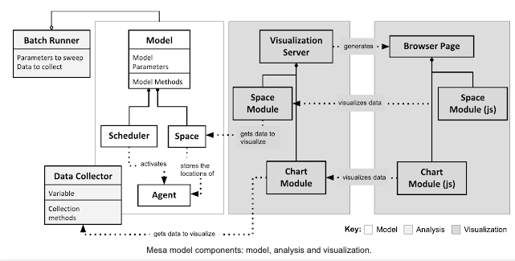
Overview of Mesa's Core Features

Slide 20
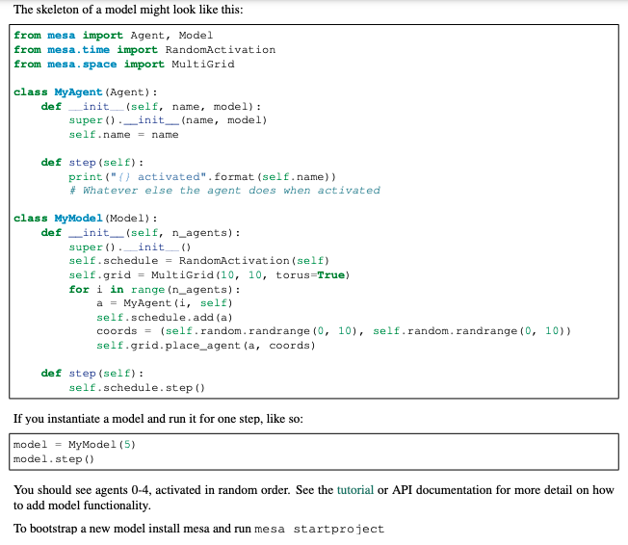
Modeling Modules

Slide 21
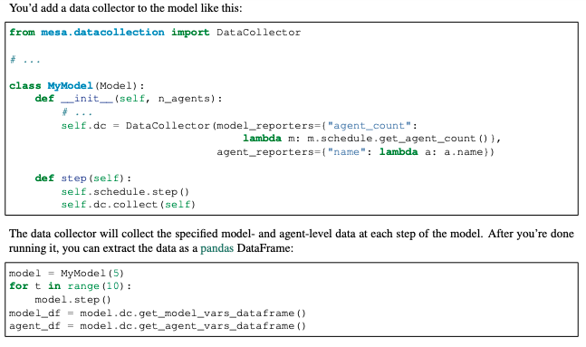
Analysis

Slide 22

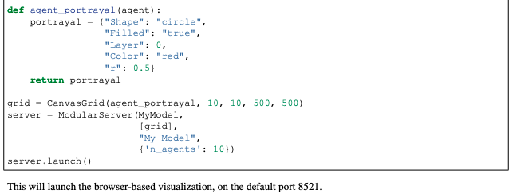
Visualization

Slide 23
Exercise - 1
Setting up the IDE - Anaconda Navigator
Installing Mesa and other libraries
Working on Jupyter Notebook
HANDSON TIME!

Slide 24
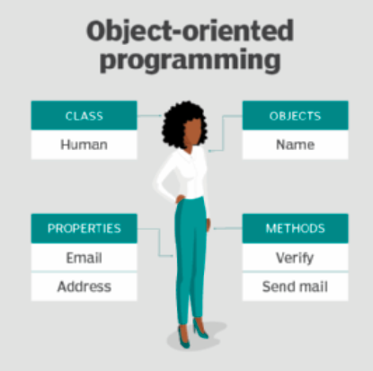
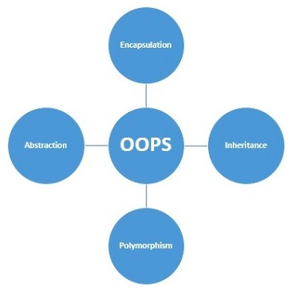
Object Oriented Programming in Python
Skip if you know the concept
Introduction: https://realpython.com/lessons/what-object-oriented-programming-oop/

Slide 25
Exercise - 2
Brush up object oriented programming
HANDSON TIME AGAIN!

Slide 26
DataCollector
Avoids looping to access data from each step.
Handles data collection and storage.
Stores 3 categories of data -
Model level variables
Agent level variables
Tables
Model-level and agent-level variables are added to the datacollector along with functions for collecting them.
Model level collection function take model objects as input
Agent level collection function take agent object as input

Slide 27
DataCollector - Collect Method
When the data collector’s collect method is called, with a model object as its argument, it applies each model-level collection function to the model, and stores the results in a dictionary, associating the current value with the current step of the model.
Similarly, the method applies each agent-level collection function to each agent currently in the schedule, associating the resulting value with the step of the model, and the agent’s unique_id.

Slide 28
DataCollector - Collect Method
A DataCollector is instantiated with two dictionaries of reporter names and associated variable names or functions for each, one for each:
model-level data and one for agent-level data;
a third dictionary provides table names and columns.
Variable names are converted into functions which retrieve attributes of that name.
Datacollector function sketch:
self.datacollector = DataCollector( model_reporters={"Model_name of your choice": model_value_at_each_step}, agent_reporters={"Agent_name_of_your_choice": agent_value_per_id_at_each_step})
Exploring DataCollector:
https://mesa.readthedocs.io/en/master/_modules/datacollection.html

Slide 29
BatchRunner
A single class to manage a batch run or parameter sweep of a given model.
Provides method to run your model with specific parameters multiple times.
Avoids the execution of for loop.
run_all() -> runs the model at all parameter combinations and store results.
self.running variable enables conditional shut off of the model once a condition is met.
Exploring BatchRunner:
https://mesa.readthedocs.io/en/master/_modules/mesa/batchrunner.html

Slide 30
Case Study 1: Boltzmann’s Wealth Distribution
The equilibrium statistical mechanics is based on the Boltzmann–Gibbs law, which states that the probability distribution function (PDF) of energy ε is
P(ε) = Ce−ε/T,
where T is the temperature, and C is a normalizing constant. The main ingredient in the textbook derivation of the Boltzmann-Gibbs law is conservation of energy.
When two economic agents make a transaction, some amount of money is transferred from one agent to another, but the sum of their monies before and after transaction is the same: m1 + m2 = m′1 + m′2
So, money is locally conserved in interactions between agents. Then, by analogy with statistical physics, one may expect that the equilibrium PDF of money m in a closed system of agents has the Boltzmann-Gibbs form P(m) =e−m/T /T, where T is the effective “money temperature” equal to the average amount of money per agent.

Slide 31
Exercise - 3
Building a sample model
Datacollector
Batchrunner
Working through the example provided by Mesa documentation

Slide 32
DAY 2

Slide 33
Visualizations
Mesa provides built-in components that allows you to create an interactive visualization of the model.
Launches a web-browser to visualize the application.
Runs the model and turns each step into JSON object.
A visualization is built up of a few different modules:
module for drawing agents on a grid.
module for drawing a chart of some variable.
modules can be created to build your own visualization
Each module has a
Python part - runs on the server and turns a model state into JSON data;
JavaScript side - takes that JSON data and draws it in the browser window.
Exploring Mesa’s visualization:
https://mesa.readthedocs.io/en/master/_modules/index.html

Slide 34
Exercise - 4
Create a visualization for boltzmann wealth distribution

Slide 35
Case Study 2: Forecasting the outcome of pandemic
A traditional framework for infectious disease spread is the so-called SIR model, dividing a population into:
- susceptible (S)
- infectious (I)
- recovered/removed
Can be estimated over time with a set of differential equations given known transition rates between states.
Depend on parameters like the R0 for the infection. These equation based methods are called compartmental models

Slide 36
Case Study 2: Forecasting the outcome of pandemic
Michigan.gov website has been actively collecting information about COVID patients at county level. The information is available on https://www.michigan.gov/coronavirus/0,9753,7-406-98163_98173---,00.html
Let us use this data to develop an SIR model to study the spread of virus using Mesa.

Slide 37
Exercise -5
Working with dataframes
Reading files from dataframes
Exploring data

Slide 38
Exercise - 6
Develop a basic network model simulation using COVID data and Mesa

Slide 39
Case Study 3: Schelling’s Segregation Model
Racial segregation has always been a pernicious social problem in the United States. Many factors have contributed to segregation including prejudice, zoning laws, housing discrimination, and loan discrimination. Although much effort has been extended to desegregate our schools, churches, and neighborhoods, the US continues to remain segregated by race and economic lines.
In 1971, the American economist Thomas Schelling created an agent-based model that suggested inadvertent behavior might also contribute to segregation. His model of segregation showed that even when individuals (or "agents") didn't mind being surrounded or living by agents of a different race or economic background, they would still choose to segregate themselves from other agents over time! Although the model is quite simple, it provides a fascinating look at how individuals might self-segregate, even when they have no explicit desire to do so.

Slide 40
Case Study 3: Schelling’s Segregation Model
The model assumptions Schelling used were the following:
- Two different types of agents are distributed in a ﬁnite 2-D space.
- In each iteration, a randomly chosen agent looks around its neighborhood, and if the fraction of agents of the same type among its neighbors is below a threshold, it jumps to another location randomly chosen in the space.
Question addressed with this model: How high the threshold had to be in order for segregation to occur

Slide 41
Exercise 7
Create a geographical visualization for Schelling’s model from the previous slide.

Slide 42
Exploring agent based modeling projects with real-world data
COVID-Agent-Based-Model with Mesa: https://github.com/metalcorebear/COVID-Agent-Based-Model

Slide 43
Integrating ABM with Machine Learning Applications
Distributed Artificial Intelligence (DAI) is a class of technologies and methods that span from swarm intelligence to multi-agent technologies. It is one of the subsets of AI where simulation has greater importance that point-prediction.
It can mainly be used for learning, reasoning, and planning.
In comparison with neural networks, they do not require the same amount of data to work .
According to Ponomarev and Voronkov (2017), a DAI can be defined by three main characteristics:
It is a method for the distribution of tasks between agents;
It is a method of distribution of powers;
It is a method of communication of the agents.

Slide 44
Integrating ABM with Machine Learning Applications
Multi-Agent Systems (and Technologies) are a fairly old class of algorithms, where individual agents interact between each other based on predetermined rules/constraints and, as a consequence, a collective behavior that is “good enough” emerges from those interactions.
The interactions that occur in the systems are both between agents and between agents and the environment itself (and become computationally intractable as number of agents grows) and most of the time an individual agent does not know ex-ante what constitutes a reward function or how to maximize it as well as has no clues on the systems dynamics — in other words, it does not know the full problem space and, even if so, it is able to only partially solve the problem. Therefore, it must discover the solution by learning.

Slide 45
Integrating ABM with Machine Learning Applications
More recent approaches indeed expect to benefit from the joint use of MAT and Machine learning (and more specifically reinforcement learning, deep learning and deep convolutional networks), since ML can use ABM as an environment and a reward generator while ABM can use ML to refine the internal models of the agents (Rand, 2007). The neural networks are therefore used as a computational approximation of the non-linear, multivariate time series generated by the ABM, or generally as computational emulators of entire ABMs (Van der Hoog, 2017).
The further step is then integrating those approaches with Graphical Models and Mean-Field Games (Mguni et al., 2018; Yang et al., 2018). Mean-Field Games, in fact, facilitate not only the interaction between individual agents but also tracks the decision-making process in huge groups of agents and studies how a single agent act in response to a group (and vice-versa).

Slide 46
Integrating ABM with Machine Learning Applications
Swarm/collective/symbiotic Intelligence deals with how natural (and artificial) systems made by multiple agents coordinate using decentralized control and self-organization. The term has been proposed by Bloom (1995) while studying complex adaptive systems and stems from a combination of different concepts (apoptosis, parallel distributed processing, group selection, and superorganism). At this point, you might observe the boundaries between the different technologies listed so far may blur, and in fact, it is very hard if not sometimes useless to clearly draw a line.

Slide 47
Integrating ABM with Machine Learning Applications
A typical swarm system has some properties you should be familiar with by now: it has many agents, which are fairly homogeneous (either identical or belonging to few typologies), and that interact between each other according to very basic rules that only exploit local information exchanged directly with another agent or via the environment (this indirect coordination mechanism is called stigmergy). The group tends eventually to self-organize and results emerge from the overall behavior of the system.

Slide 48
Integrating ABM with Machine Learning Applications
Those single individual behaviors can often be described in probabilistic terms, i.e., each agent stochastically acts based on his local perception of the neighborhood. This is a very key point because jointly with the above properties they assure that the system can be scaled, parallelized, and made fault-tolerant. It also lays down a further consideration on any SI algorithm. In fact, it is not only distributed (run separately by each agent in the system) but also embeds some degree of randomness in the decision process of each node. This may look trivial or useless but is the reason why the system does not get stuck in “locally compressed states” (Cannon et al., 2016). In other words, this gives the chance to a swarm that clustered into several isolated subgroups to have an individual who is keen to leave the group and keep the entire interactive process alive.

Slide 49
Integrating ABM with Machine Learning Applications
Van Der Hoog, S. (2017). “Deep Learning in (and of) Agent-Based Models: A Prospectus”. Preprint arXiv: 1706.06302.
Rand, W. (2007). “Machine learning meets agent-based modeling: when not to go to a bar”. Unpublished Paper.
Yang, Y., Luo, R., Li, M., Zhou, M., Zhang, W., Wang, J. (2018). “Mean Field Multi-Agent Reinforcement Learning”. arXiv:1802.05438.
Stone, P., Veloso, M. (2000). “Multiagent Systems: A Survey from a Machine Learning Perspective”. Autonomous Robots, 8 (3): 345–383.
Rosenberg, L. B. (2016). “Artificial Swarm Intelligence, a Human-in-the-loop approach to A.I.” In: Proceedings of the Thirtieth AAAI Conference on Artificial Intelligence (AAAI-16): 4381–4382.

Slide 50
Resources
Agent Based Modeling: https://math.libretexts.org/Bookshelves/Scientific_Computing_Simulations_and_Modeling/Book%3A_Introduction_to_the_Modeling_and_Analysis_of_Complex_Systems_(Sayama)/19%3A_AgentBased_Models/19.01%3A_What_Are_Agent-Based_Models%3F
Mesa Documentation:
http://conference.scipy.org/proceedings/scipy2015/pdfs/jacqueline_kazil.pdf
https://readthedocs.org/projects/mesa/downloads/pdf/stable/
Mesa Technical Document: https://mesa.readthedocs.io/en/master/_modules/index.html
Mesa Examples:
Github: https://github.com/projectmesa
Agent-based Model for tumor-analysis using Python+Mesa: https://arxiv.org/abs/1909.01885
Covid19-Mesa: https://github.com/ncsa/COVID19-mesa

Slide 51
Resources
Boltzmann Wealth Distribution: Statistical Mechanics of Money, Income, and Wealth: A Short Survey : Adrian A. Dragulescu, Victor M. Yakovenko: https://arxiv.org/abs/0905.1518
SIR Model: https://www.maa.org/press/periodicals/loci/joma/the-sir-model-for-spread-of-disease-the-differential-equation-model
Schelling’s Model: Thomas C Schelling, Harvard University : https://www.stat.berkeley.edu/~aldous/157/Papers/Schelling_Seg_Models.pdf
Schelling’s Model for further practice: http://nifty.stanford.edu/2014/mccown-schelling-model-segregation/

Slide 52
Question and Answers

